Slide 1
Brain Tumor Image Classifier
Alex Lai
Notes:
For context our will be presenting to my project manager of the hospital to help them provide a potential solution to a specific problem.
My name is Alex Lai and our would like to show a potential solution for our company’s brain MRI issue.

Slide 2
Problem Statement
Problem
Too many unorganized brain MRIs that need to be sorted as having cancers or not.
Need a train eye.
The amount of images is too much for doctors
Solution
To make an image-processing brain tumor predictive model to automate this problem on scale.
CNN model on pytorch.
Stakeholders
Hospital
Doctors
Consider as pass
And we wish to have a validation loss under 0.15, no signs of overfitting, and an accuracy of 95%. This is just to make a quick prototype of a model working.
Notes:
The problem
Our hospital has lots of unorganized brain MRIs and wants to be able to sort which ones have brain tumors or not. And some of these images have benign normal tumors that are not cancerous, but can only be differentiated from an expert. The amount of images is too much for doctors to take time out of their busy day and scan them all. Thus we need a solution that can automate this process while also having the skills of an expert.
The solution
To make an image-processing brain tumor predictive model to automate on scale. It will be a CNN model done on pytrorch.
Our stakeholders are the hospital and doctors
And we wish to have a validation loss under 0.1, no signs of overfitting, and an accuracy of 95%

Slide 3
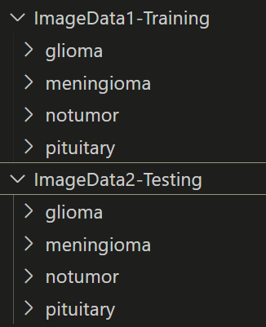
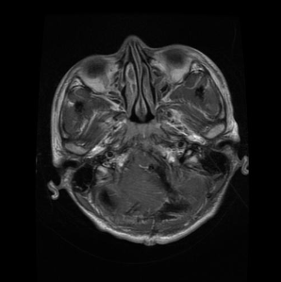
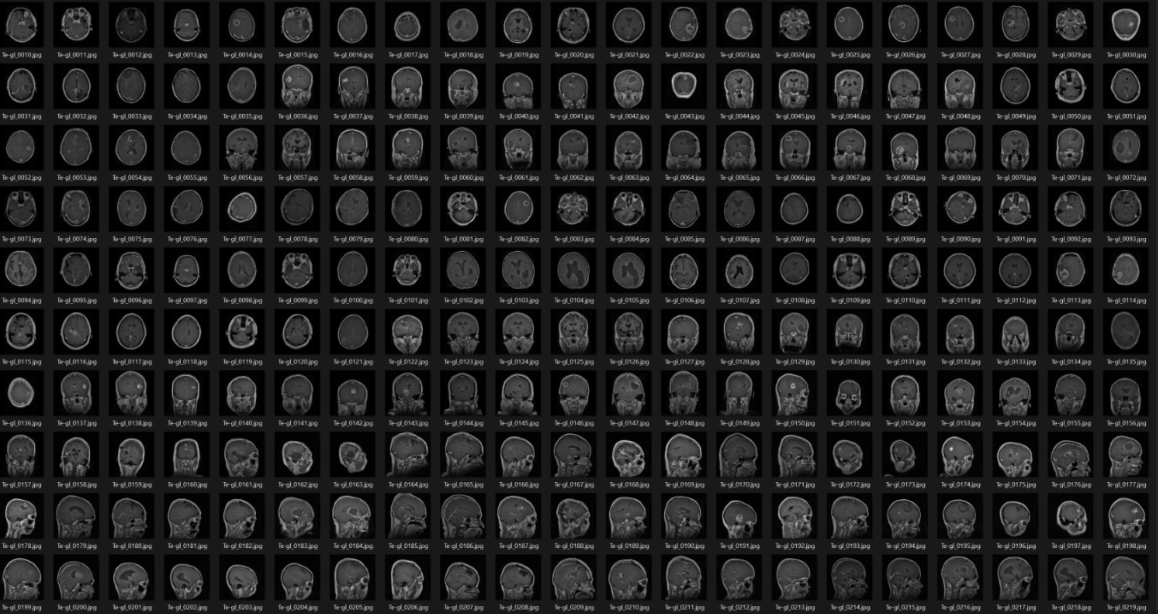
Description of Dataset
This data was provided by the IEEE Data Port:
https://ieee-dataport.org/documents/brain-tumor-mri-dataset
And is available on Kaggle:
https://www.kaggle.com/datasets/masoudnickparvar/brain-tumor-mri-dataset
This data under the license CC BY 4.0 ATTRIBUTION 4.0 INTERNATIONAL Deed: https://creativecommons.org/licenses/by/4.0/
Data folder structure
Grayscale images
Just a sample of all the data
Notes:
We got the data from IEEE Data Port and kaggle. We have permission due to the CC 4.0 attribution license which we are attributing to them now
Data is split into 2 main folders, testing and training; with 4 subfolders of different brain mri scans
All images are grayscale so only one channel is needed when designing the CNN model.
And here is a sample of the image data we will be using.

Slide 4
Brain MRI info
Glioma - A type of cancer arising from glial cells in the brain or spinal cord.
Actual Cancer
Meningioma - Usually a benign tumor from the meninges; rarely malignant.
Notumor - Means no tumor was found.
Pituitary - Refers to the gland; tumors (mostly benign) can form, rarely cancerous.
Notes:
Remember this info as will be used later.
All the image are split into 4 subfolders that are
Glioma - A type of cancer arising from glial cells in the brain or spinal cord.
Actual Cancer
Meningioma - Usually a benign tumor from the meninges; rarely malignant.
Notumor - Means no tumor was found.
Pituitary - Refers to the gland; tumors (mostly benign) can form, rarely cancerous.

Slide 5
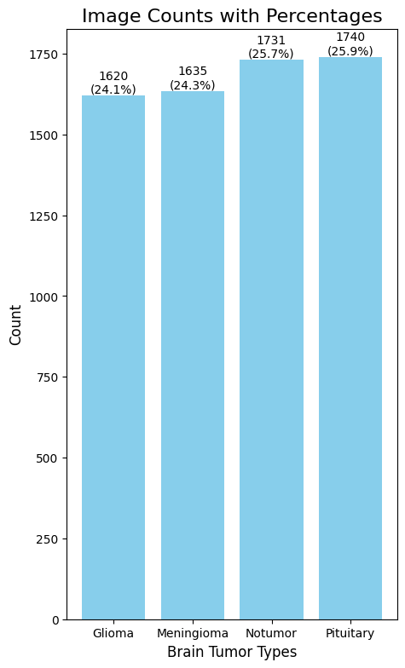
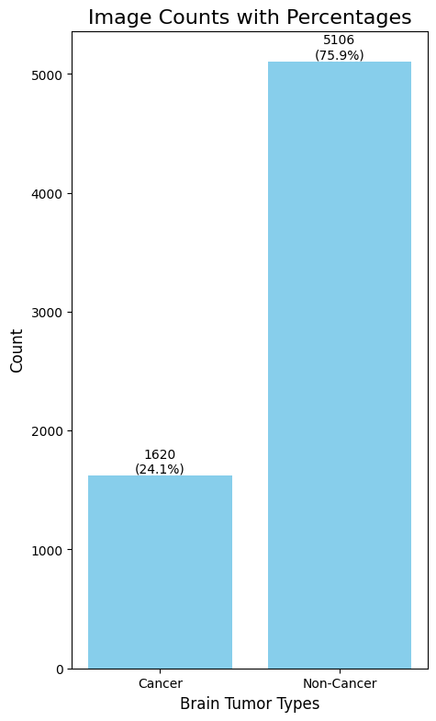
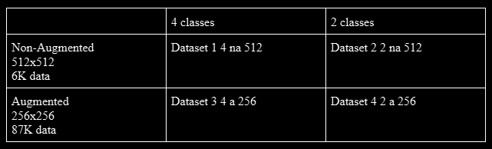
The Plan
End goal is to make a model where you input image data of Brain MRI and will classify either Cancer or No Cancer.
We will be experimenting with different data set ideas.
Idea 1 is keep it as 4 classes
Glioma, meningioma, notumor, pituitary
Idea 2 is to make it 2 classes.
Glioma as ‘cancer’
Meningioma, notumor, pituitar all as ‘no cancer’.
Data will be imbalanced
Notes:
End goal is to make a model where you input image data of Brain MRI and will classify either Cancer or No Cancer.
We will be experimenting with different data sets and different model methods.
One idea is to 4 classes (glioma, meningioma, notumor, pituitary), and have the model try to classify the 4 classes, which we will then have a simple code redirect into a 2 classification solution (cancer or no cancer ).
The idea is that the model will place more effort into separating into 4 classifications, which already have balanced data and thus be more accurate. And then we can add another layer to organize the results of 4 classifications into 2 classifications of either cancer or no cancer.
Another idea is to have the Glioma class as cancer and the rest of the classes merged as not cancer. Then train the AI to classify between the 2 classes. But this will create a data imbalance issue that we will have to address.

Slide 6
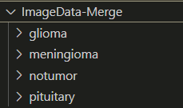
Merge Data for Cross Validation
Cross validation will need K folds from one sample source
Original data was split, will merge them together as then easier to create folds for Cross Validation.
Notes:
We are going to be testing multiple different models and data sets and use cross-validation to decide which one is the best. Since we will be using cross-validation then that means we will be splitting up the data with k-folds. Since the current data is already split up into train and test pairs, then that means our have to merge the data together and then use code to split them up.
Original data was split, and since will be doing Cross Validation, then will merge them together as then easier to create folds for Cross Validation.

Slide 7
Cleaning Data Methods
Scan for corrupted images and delete those.
Scan for duplicate images and delete those.
Scan for Images if varying files sizes
Some outliers but checked and not that big of an issue
Standardized the images by scaling the pixel values between 0 and 1.
Notes:
Original data was split, and since will be doing Cross Validation, then will merge them together as then easier to create folds for Cross Validation.

Slide 8
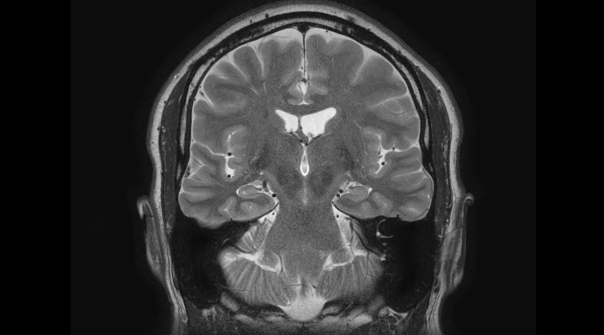

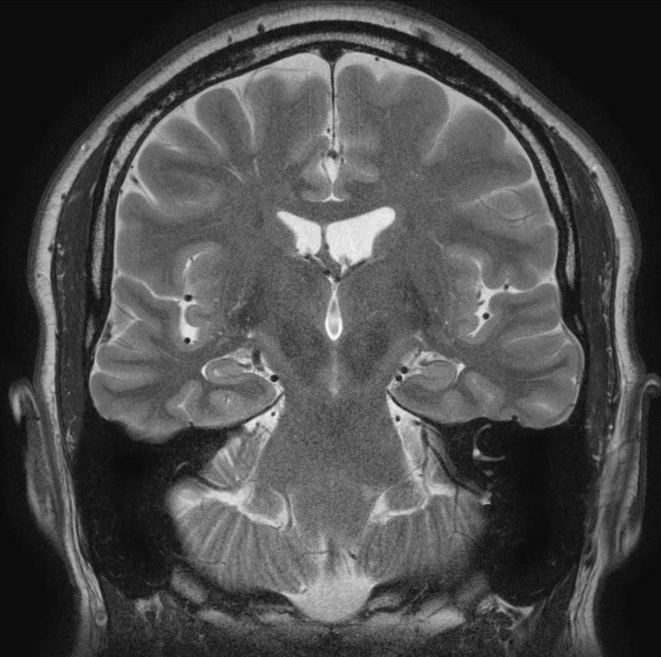
Resize Image Data
Alot of images are of different size.
Original
Resized (stretched/squashed):
1st Attempt
Original
Crop then Resize:
2nd Attempt
Notes:
Since our will be using a CNN, that means it is preferred that all the images will have to be standard size. Majority of our images are 512x512, but a decent proportion are of different dimension sizes. Since majority is 512x512 then From our last info it appears majority of the images are 512x512 so will resize it to those dimensions.
Our 1st attempt to resize the images was just to use the normal resize function but that caused some images to stretch and will definitely affect the CNN’s filters on specific shapes.
Our 2nd attempt was to crop first then resize. We decided to crop as assuming more of the wrong-resolution pictures will have the tumors in the middle of the picture and the things that will be cropping out are not that important in the beginning. And the results look good.

Slide 9
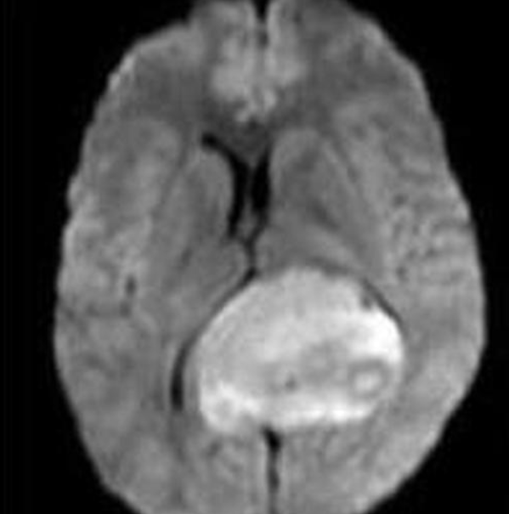
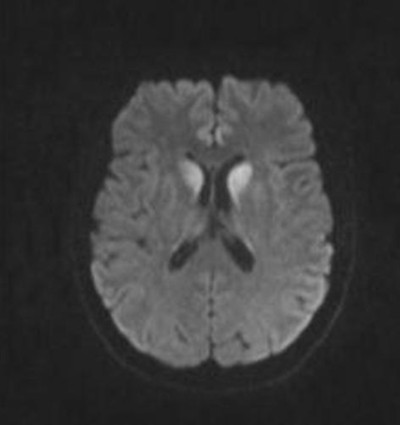
Check for Blurry Images after resizing
Laplacian variance method
Threshold set to 10
Deleted the images
Notes:
We went to scan for blurry images using the Laplacian variance method. We set the threshold to 100 and all the images looked good and kept setting it lower til 10, and returned images that we inspect are truly blurry. I checked the images and yes they do seem too blurry for the AI, so we deleted them.

Slide 10
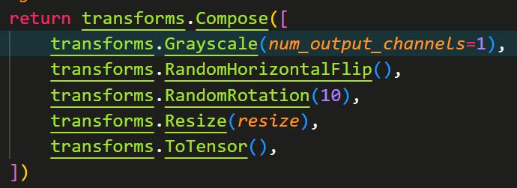
Convert to grayscale
Notes:
Though all images appear grayscale their format is still using RGB 3 channels, so we use the data transform class to convert them all to grayscale.

Slide 11
Data Augmentation
Notes:
Also, to make the most of out data, in the python data transform class ouram using a feature that allows the data to be randomly flipped or rotated. This should make the model more robust in determining.

Slide 12
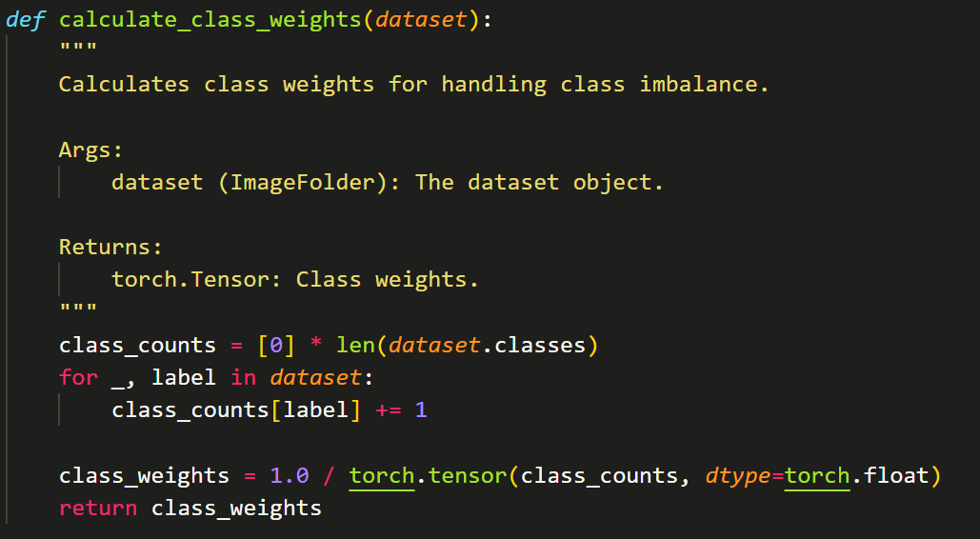
Data Imbalance
4 class data balance
2 class data imbalance
Make minority class weigh more in training
Notes:
So currently the 4 class data is balanced but the 2 class data in imbalance from merging 3 classes together.
To solve, when making the data set folds, we added another function to calculate the class weights to help make the minority class weight more during model training.

Slide 13
Batch Size
Things to consider:
image dimension -
Amount of data -
Batch size -
VRAM memory -
Time -
512x512 images
6K amount of data
64 Batch size
Max 24GB VRAM memory
Within time of 8 hours
batch size 256 with 512 x 512 images took longer than 30 min to run for only 1 fold, 97% GPU utilization
batch size 128 with 512 x 512 images took longer than 30 min to run for only 1 fold, 97% GPU utilization
batch size 64 with 512 x 512 images took 3:50 min for 1 fold, 14 GB VRAM, 40% GPU utilization
Notes:
Since our hospital can only afford a 4090 GPU to trial run this, we had to find a good compromised in image dimension. Batch size, VRAM memory, and time.
Our images are 512x512, 6K amount of data, with a Batch size of 64 to parallel compute at the same time, the 4090 only has a max of 24GB VRAM memories, and we want to finish this within
time of 8 hours to make a quick prototype to show to the higher ups.
We can’t really adjust alot of these, only image size and batch size.
So we experimented with different batch size and alot of them bottleneck the GPU until we reach a batch size of 64 and worked amazingly.

Slide 14
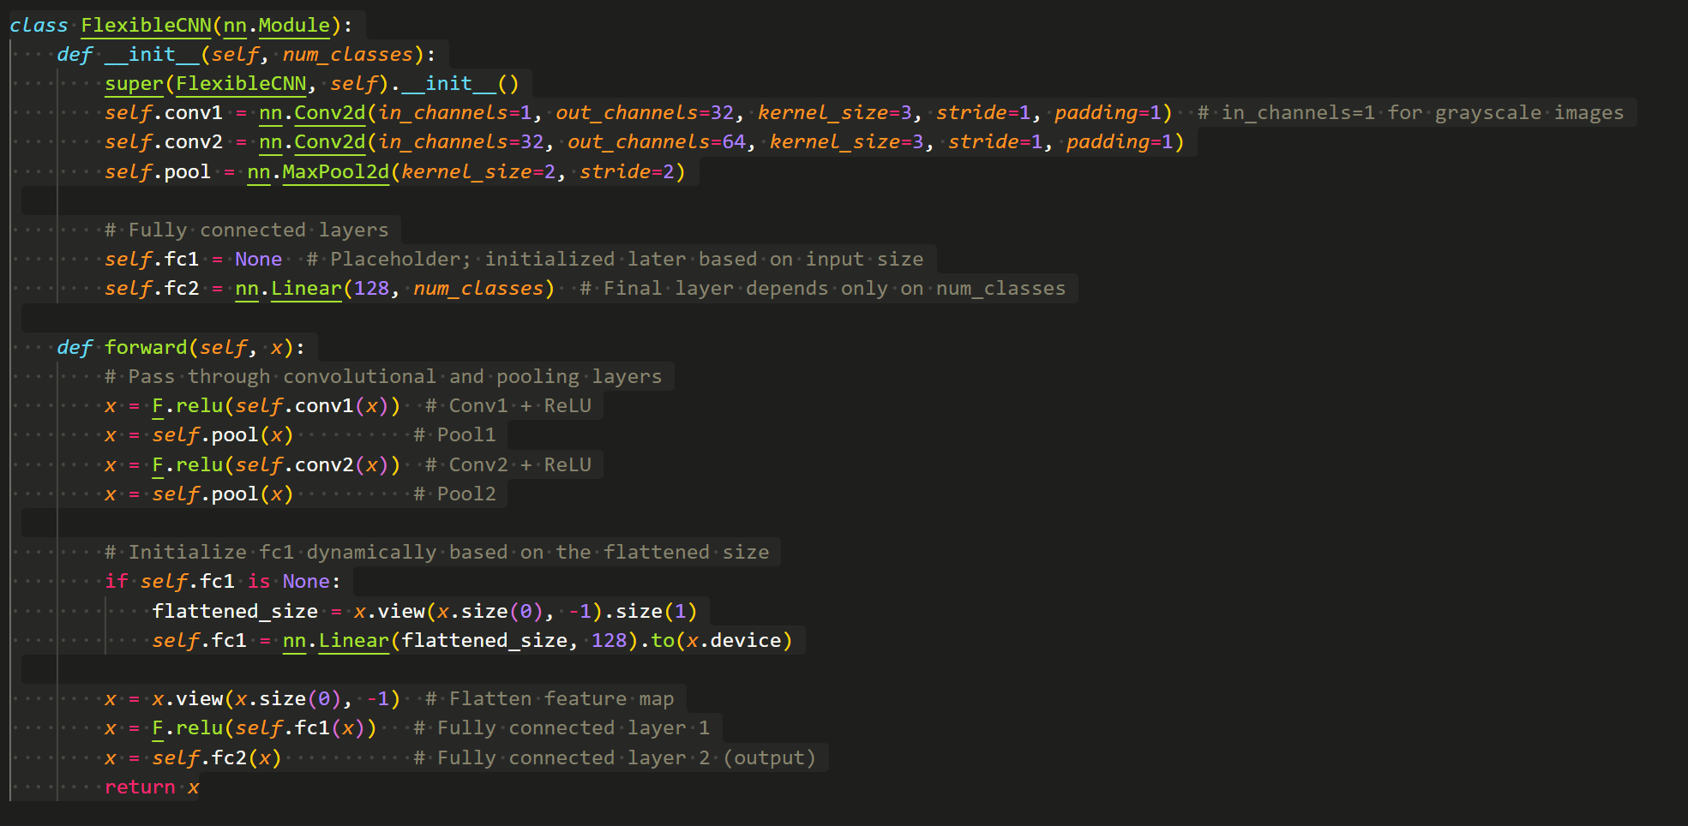
CNN model design
512x512 grayscale images batch size 64
Conv layer 32 filters
Conv layer 64 filters
Pooling layer
Output layer to number of classes
Model 1 is 4 clases Model 2 is 2 classes
Notes:
Here is the Convolution Neural Network model design that we are testing.
The first layer is conv layer with 32 filters (you can notice the in channel is set to 1 for grayscale images), then another conv layer increased to 64 filters, then pooling layer, then output layers to the number of classes within the dataset (model 1 is 4 classes, and model 2 is 2 classes.
The reason we have each convolution layer increasing in filters is because we are hoping the first conv layer will learn basic reusable patterns, and the 2nd layer with more filters will learn more variety of more complex patterns. The pooling layer in this case is mainly to make the processed image easier to compute for the next layer.
This type of model architecture was chosen as a compromise to speed up production and to match the small data of 6K we have.

Slide 15

Cross validation & K folds
Each time run a folds alternates which fold is used for validation
All data sets
Divide up into 5 folds
Each model will run each fold 10 epochs
Notes:
We are using the k fold method for cross validation. Basically we divide up the total data set into 5 folds and each time you’re running a fold one fold is selected to be used for validation and the other 4 as used for training.5 folds was chosen as to be inline with the 80 20 training validation split.
And for each fold we will run 10 epochs,

Slide 16
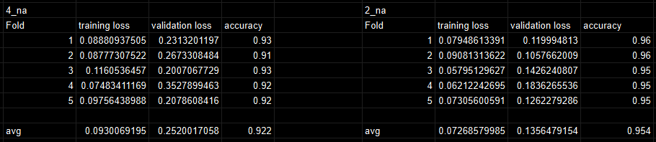
Modeling Results
Model 1 with 4 classes
Model 2 with 2 classes
winner
Notes:
And here are the results.
It appears model 2 avg validation loss is the lowest, and just by looking at all the data across the board is the lowest.

Slide 17
Modeling Results
Model 1 with 4 classes
Model 2 with 2 classes
Slight overfitting?
Notes:
Both models seems to have the training loss a bit lower than the validation loss across the board, This hints that slight overfitting happening. But in model 2, it seems this is not much of an issue.

Slide 18
Modeling Results
Model 1 with 4 classes
Model 2 with 2 classes
winner
Notes:
Model 2's accuracy seems to be the highest.
It seems the overall best model method to going forth is model 2 with the idea of merging the data set together

Slide 19
Modeling Results
Model 1 with 4 classes
Model 2 with 2 classes
Val Loss Winner
Accuracy Winner
Both are Slight Overfitting?
Notes:
Model 2's accuracy seems to be the highest.
It seems the overall best model method to going forth is model 2 with the idea of merging the data set together

Slide 20
Conclusion, Future Work, & Improving the model
Conclusion:
Chose Model 2 with the dataset of merging the data into 2 classes.
Possible issues:
Possible mislabeling
Future Works:
Experiment with augmenting the data (rot and flip) which will increase the data set from 6K to 87K
Optimize the parallel computing to process more data faster
Experiment different types of CNN models structures than only the simple one. Chose small as dataset was small.
Notes:
And thus we came to the conclusion to use Model 2. It seems that merging the 4 classes into 2 classes is easier on the model than 4 classes.
Though the AI is good in the testing phase we have not tried it out on the field yet. There is always a risk the AI itself can mislabeling patient brain MRI with false positive cancers or false negative cancers. In our backlog of images the risk is that bad, but if we eventually used this for patients in real time after they took their MRI, mislabeling can open the hospital up to lawsuits.
Thus why our propose to further improve the AI more.
We would like to research more on why merging into 2 classes is better than 4.
We would like to experiment with augmenting the data (rot and flip). Upon experimenting, with this method we can increase the amount of data sets from 6K to 87K.
Of course, we tried that method and it took 2 hours for one fold thus will need to figure out a more optimized solution to expedite the process.
One method is to optimize parallel computing to process more data faster.
Experiment with different types of CNN model structures than only the simple one.

Slide 21
Thank You
Questions?
Notes:
Thank you that’s all, any questions?

